Slide 1
Pointer to object

Slide 2
You can access an object either directly, or by using a pointer to the object.
To access an element of an object when using the actual object itself, use the dot operator.
To access a specific element of an object when using a pointer to the object, you must use the arrow operator.

Slide 3
class My_Class {
int num;
public:
void set_num(int val)
{num = val;}
void show_num()
{
cout << num << "\n";
}
};
int main()
{
My_Class ob, *p; // declare an object and pointer to it
ob.set_num(10); // access ob directly
ob.show_num();
p = &ob; // assign p the address of ob
p->show_num(); // access ob using pointer
}

Slide 4
Pointer to derived class

Slide 5
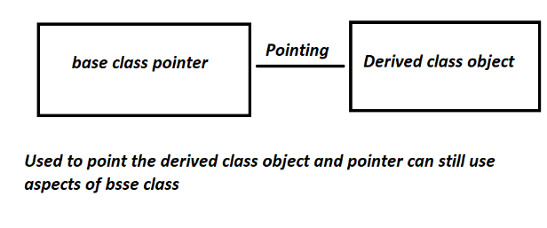

Slide 6
C++ program to illustrate the
implementation of the base class
pointer pointing to derived class

Slide 7
#include <iostream>
using namespace std;
class lpu {
public:
int var_base;
void display()
{
cout << "Diiiisplaying Base class"
<< " variable var_base: " << var_base << endl;
}
};

Slide 8
class mca : public lpu {
public:
int var_derived;
void display()
{
cout << "Displayingggg Base class"
<< "variable var_base: " << var_base << endl;
cout << "Displaying Derived "
<< " class variable var_derived: "
<< var_derived << endl;
}
};

Slide 9
int main()
{ // Pointer to base class
lpu *lpuptr;
lpu obj_base;
mca obj_derived;
// Pointing to derived class
lpuptr = &obj_derived;
lpuptr->var_base = 34;
// Calling base class member function
lpuptr->display();

Slide 10
mca *derived_class_pointer;
derived_class_pointer = &obj_derived;
derived_class_pointer->var_base = 9448;
derived_class_pointer->var_derived = 98;
derived_class_pointer->display();
}

Slide 11
Early binding and Late binding

Slide 12
Binding refers to the process of converting identifiers (such as variable and performance names) into addresses.
Binding is done for each variable and functions.
For functions, it means that matching the call with the right function definition by the compiler.
It takes place either at compile time or at runtime.

Slide 13
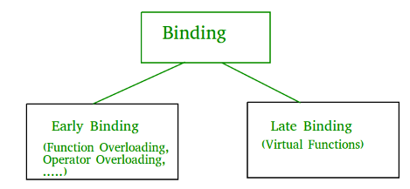

Slide 14
Early Binding (compile-time time polymorphism)
As the name indicates, compiler (or linker) directly associate an address to the function call. It replaces the call with a machine language instruction that tells the mainframe to leap to the address of the function.

Slide 15
#include<iostream>
using namespace std;
class Base
{
public:
void show() { cout<<" In Base \n"; }
};
class Derived: public Base
{
public:
void show() { cout<<"In Derived \n"; }
};

Slide 16
int main(void)
{
Base *bp = new Derived;
// The function call decided at
// compile time (compiler sees type
// of pointer and calls base class
// function.
bp->show();
}

Slide 17
Late Binding : (Run time polymorphism)
In this, the compiler adds code that identifies the kind of object at runtime then matches the call with the right function
This can be achieved by declaring a virtual function.

Slide 18
#include<iostream>
using namespace std;
class Base
{
public:
virtual void show() { cout<<" In Base \n"; }
};
class Derived: public Base
{
public:
void show() { cout<<"In Derived \n"; }
};

Slide 19
int main(void)
{
Base *bp = new Derived;
bp->show(); // RUN-TIME POLYMORPHISM
}

